Slide 1


Middle East Technical University
Department of Electrical and Electronics Engineering
Modeling and Simulation
with
MATLAB/Simulink
Mesut Uğur
03.03.2017

Slide 2


Önce reklamlar…
http://power.eee.metu.edu.tr/
http://keysan.me/
http://blog.metu.edu.tr/ugurm/

Slide 3
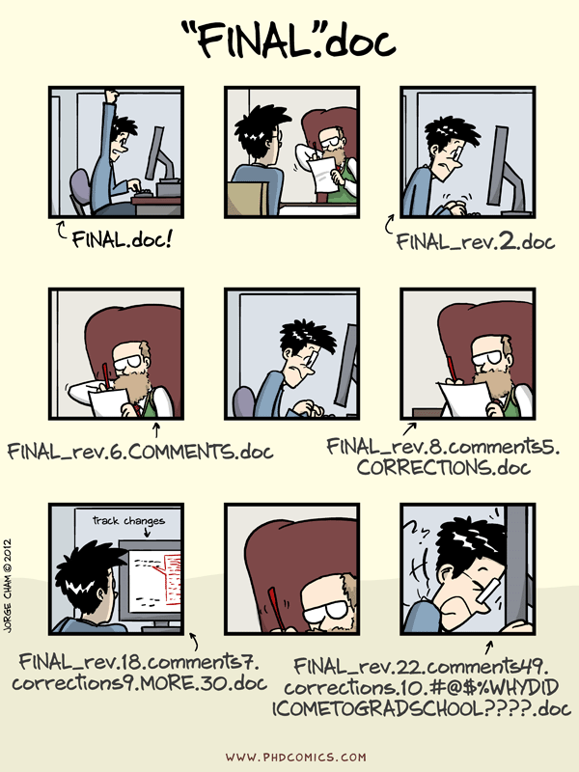
Version Control - What is it?

Slide 4
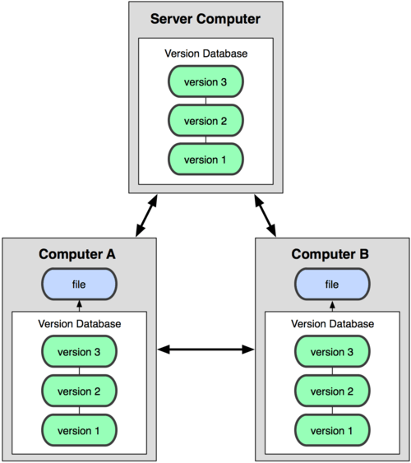
Version Control - What is it?
Revision history, track changes
Collaborative work
Backup and restore
You use more than one computer
You are in collaboration with several people
You have a thesis supervisor who wants to check your progress regularly
Self regulation
etc. etc.

Slide 5
Version Control - Github
Repository (repo)
Server
Client
Pull
Push
Fetch
Commit
Branch
Merge
Clone

Slide 6
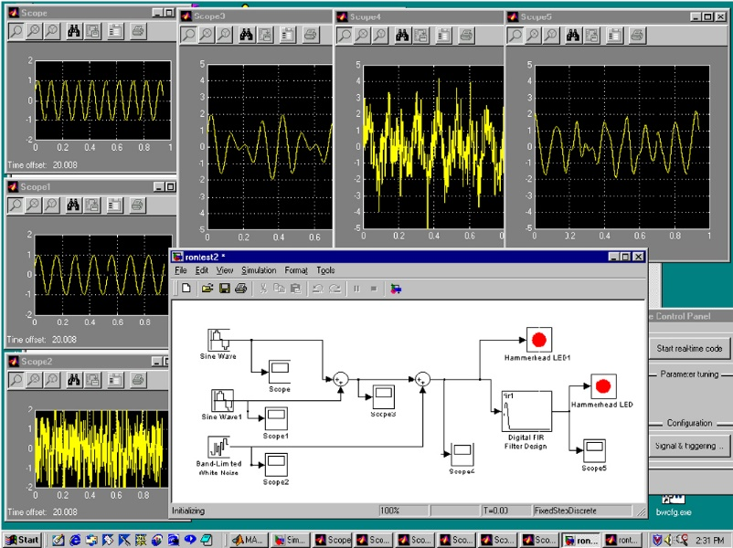
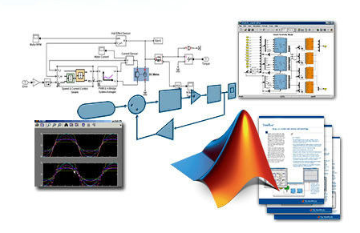
MATLAB/Simulink
What is it?
Graphical programming environment
Modeling, simulation, analysis
Multi-domain dynamic systems
Model based design (embedded systems)
Rich library
Integration with the rest of MATLAB

Slide 7
MATLAB/Simulink
Why is it?
Flexible: Integration with MATLAB!
Export data to use in MATLAB (Writing a thesis)
Import data to simulate from MATLAB (Optimization example)
Multi-software simulation (Comsol example)
You can imitate many things! (DSP example)
Integrated simulation (Complex multi-domain systems)
Widely used (Google it!)
Simulink Help/Docs

Slide 8
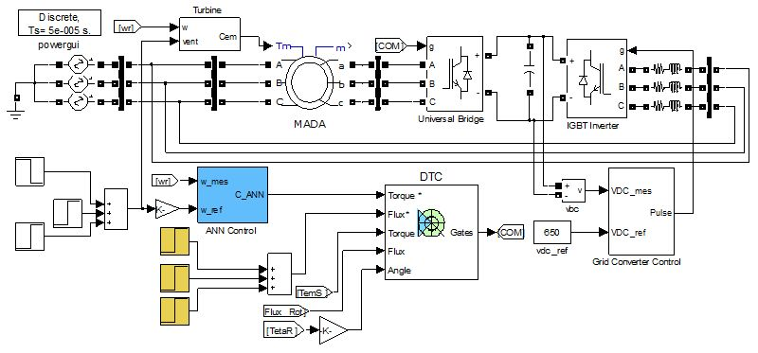
MATLAB/Simulink
Wind Energy System

Slide 9
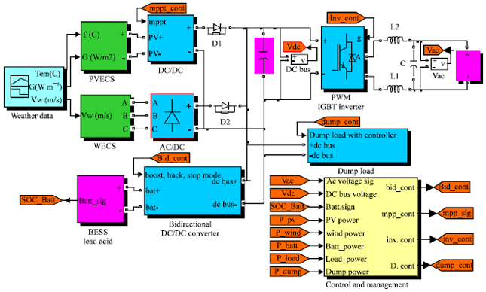
MATLAB/Simulink
Photovoltaic System

Slide 10
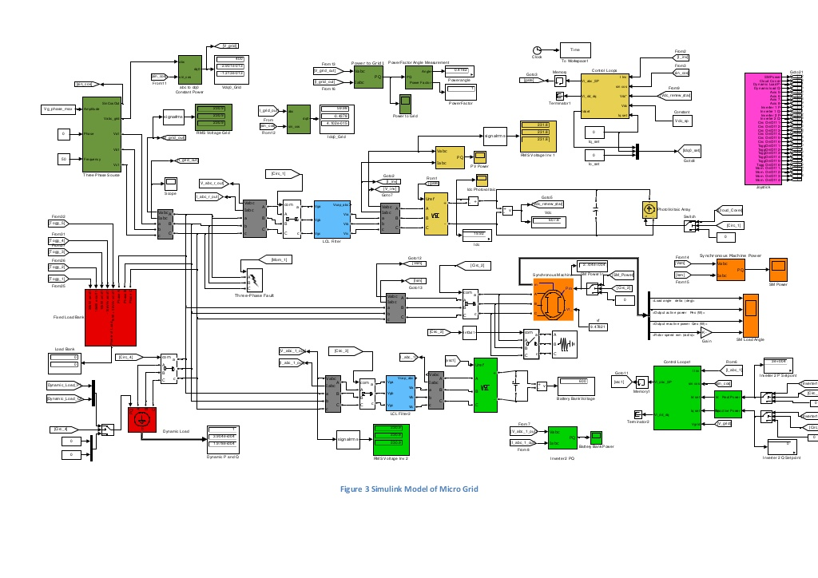
MATLAB/Simulink
How complex?

Slide 11
MATLAB/Simulink
How does it work?
When you hit RUN;
Compilation: Model is converted to an executable form
Allocation of memory (signals, states, run-time parameters)
Block priorities
Order of execution
Simulation loop (compute states and outputs)
Simulation step time: Variable or fixed

Slide 12
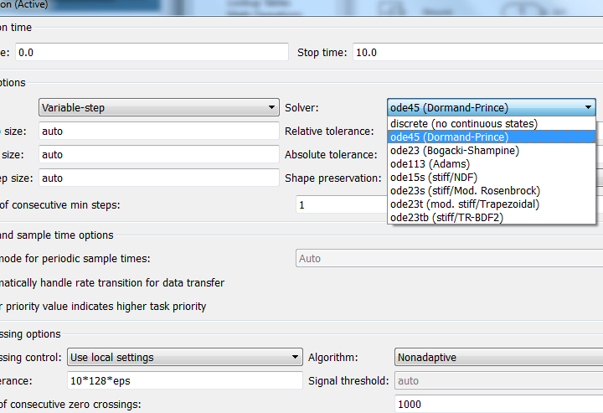
MATLAB/Simulink
Solvers
Fixed step, variable step
Continuous, discrete
Discrete signals: Difference equations
Continuous signals: Numerical integration (ODE)

Slide 13
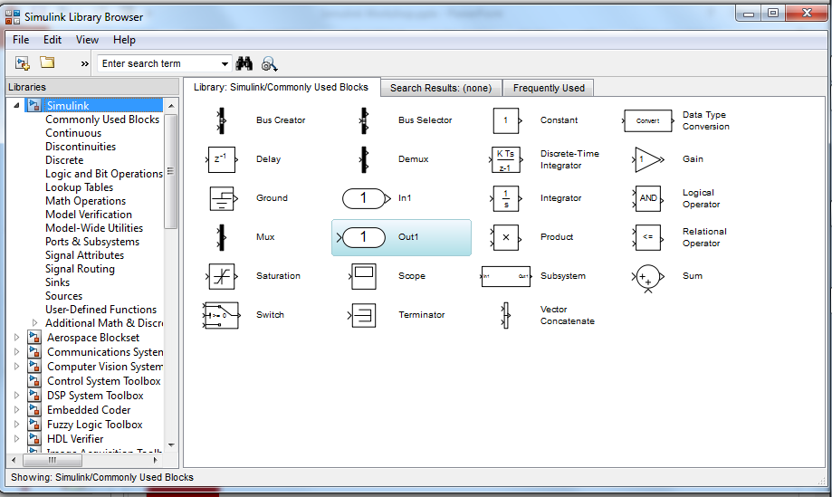
MATLAB/Simulink
Library
Logic, math, control, source, sink, display, if/switch, in/out
User defined functions
Digital signal processing, communication, control, fuzzy logic, neural network, optimization, system identification, image processing……
SimRF, SimScape, SimElectronics, SimMechanics, SimPowerSystems

Slide 14
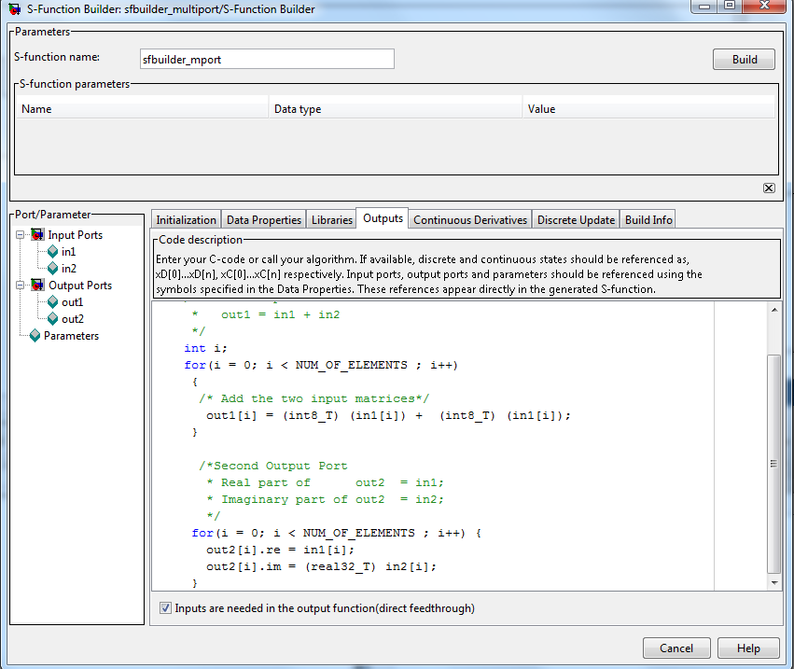
MATLAB/Simulink
S-function
Embed object code into Simulink model
MATLAB, C, C++, Fortran
User defined functions
S-function API: Interact with Simulink engine
S-function builder

Slide 15
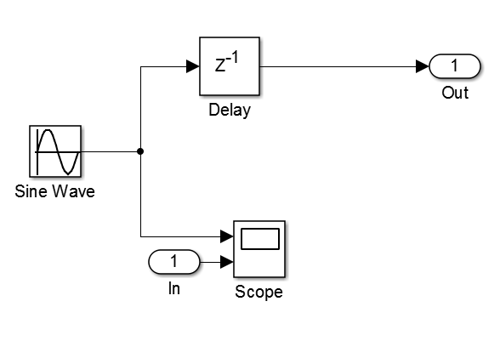
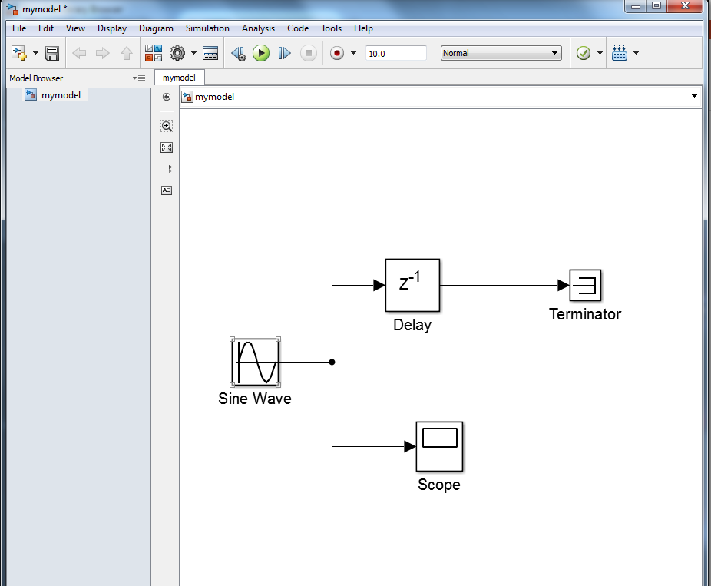
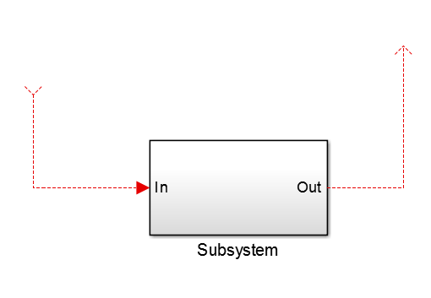
MATLAB/Simulink
Model
Block
Script
Sub-system

Slide 16
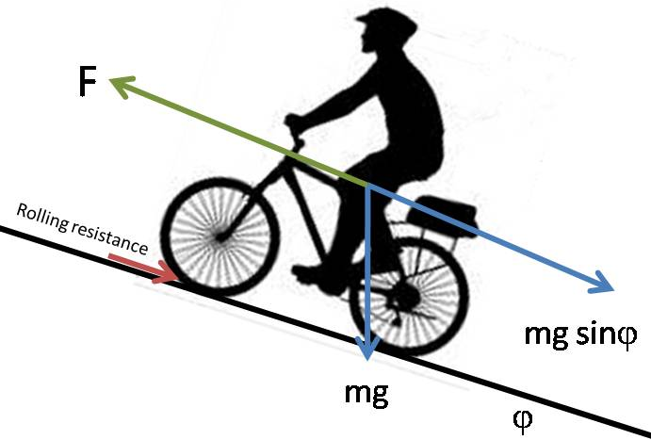
MATLAB/Simulink
Modeling
Let us give an example
Gravitational force: mgsin(α)
Friction force: Bv
Windage force: Cv²
Tractive force: F
Gearbox
Train Wheel
Motor
Motor Drive
Inverter Control
…..
….
…
..
.

Slide 17
MATLAB/Simulink
Enough talking!
Very first model
Model configuration parameters
Compile and run
Examples: Part 1
Common blocks
Filter (transfer functions)
PID control
Mechanical system

Slide 18
MATLAB/Simulink
Enough talking!
Examples: Part 2
Rectifier
Buck converter (Control)
DC motor
Chopper (PWM)
Motor drive
Integration with MATLAB
Exporting data
Calling Simulink model from MATLAB

Slide 19

MATLAB/Simulink

Slide 20
MATLAB/Simulink

